Slide 1
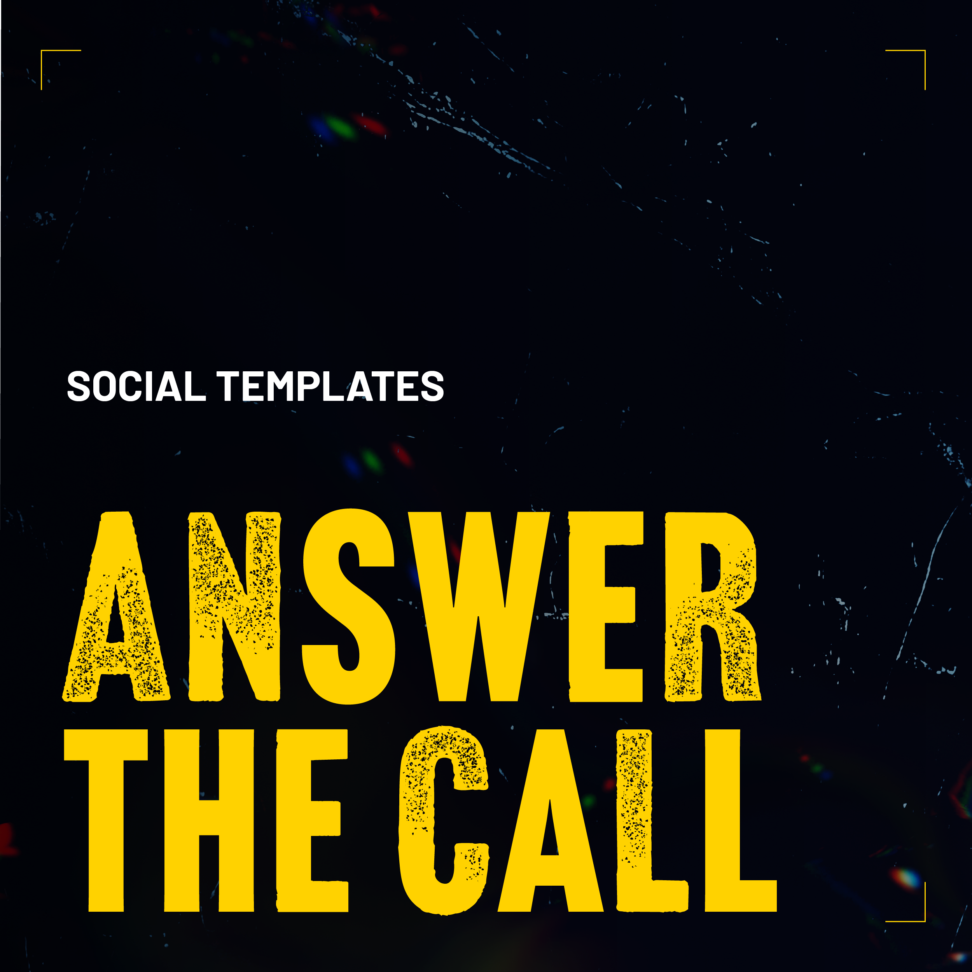

Slide 2

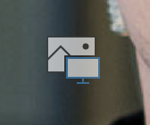
How to customize your text and images
Edit text
A brand font is embedded in this file. All text on templates should display as “Barlow” font. Sample messaging is provided in the Answer the Call toolkit.
  Edit text by clicking the text box and typing your message.
  If copying text from another file, paste copy into text box and check it is still formatted to Barlow font.
  Text should always be in white.
Change Image
We recommend using portraits of officers that are cropped in the same way as the example photos to ensure the images match others from ’Answer the Call.’
  Select the “Insert Picture” button on the slide. Select the destination where your photo is saved and choose the image you’d like to insert.
  If picture’s position needs adjusting, right-click on the image, then select “crop” in the pop-up menu. Move or scale the image as needed, then click outside of the container when finish.
  (cont’d…)

Slide 3

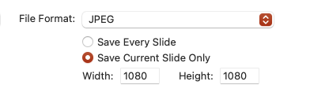
Exporting your images
Select the slide or page that you want to export after customizing the images or text.
Select File > Export.
Choose the file destination.
A dialogue box will appear. Choose JPEG file format and ensure that the image dimensions are set to 1080 x 1080 (See screenshot).
Save your image and share on social media.

Slide 4


